Slide 1


AWS CodeDeploy &
CodePipeline
Wolfgang Unger
AWS Solutions architect | INSTRUCTOR
AWS fully managed deploy and pipeline services

Slide 2

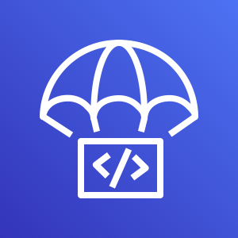
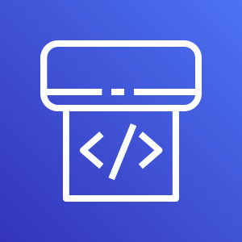
CodeDeploy & CodePipeline
Wolfgang Unger
AWS Solutions Architect | instructor

Slide 3


Lesson overview
Introduction
CodeDeploy &
CodePipeline
CodeDeploy
BuildPipeline
Chapter Overview
Wolfgang Unger
AWS |Solutions Architect | Instructor

Slide 4

CodeDeploy AWS definition :
“AWS CodeDeploy is a fully managed deployment service that automates software deployments to a variety of compute services such as Amazon EC2, AWS Fargate, AWS Lambda, and your on-premises servers. AWS CodeDeploy makes it easier for you to rapidly release new features, helps you avoid downtime during application deployment, and handles the complexity of updating your applications”
Notes:
Karel Capek, a Czech novelist introduced and made popular the word robot as a word for artificial human beings. It first appeared in his play R.U.R. (Rossum’s Universal Robots) in 1920. In Czech, the word means worker or servant.

Slide 5
CodeDeploy is a deployment service that automates application deployments to Amazon EC2 instances, on-premises instances, serverless Lambda functions, or Amazon ECS services.
Notes:
The official definition of a robot, by Robot Institute of America.

Slide 6
CodeDeploy
01100110
11001101
10000101
11100111
deploys your code to Amazon EC2 instances, on-premises instances, serverless Lambda functions, or Amazon ECS services.

Slide 7

Benefits
1
Server, serverless, and container applications
CodeDeploy lets you deploy both traditional applications on servers and applications that deploy a serverless AWS Lambda function version or an Amazon ECS application.
2
Automated deployments.
CodeDeploy fully automates your application deployments across your development, test, and production environments. CodeDeploy scales with your infrastructure so that you can deploy to one instance or thousands..
3
Centralized control.
You can launch and track the status of your deployments through the CodeDeploy console or the AWS CLI. You receive a report that lists when each application revision was deployed and to which Amazon EC2 instances.

Slide 8
CodePipeline AWS definition :
“AWS CodePipeline is a fully managed continuous delivery service that helps you automate your release pipelines for fast and reliable application and infrastructure updates. CodePipeline automates the build, test, and deploy phases of your release process every time there is a code change, based on the release model you define”
Notes:
Karel Capek, a Czech novelist introduced and made popular the word robot as a word for artificial human beings. It first appeared in his play R.U.R. (Rossum’s Universal Robots) in 1920. In Czech, the word means worker or servant.

Slide 9

CodePipeline
source
build
deploy
models, visualizes, and automates the steps required to release your software.

Slide 10
Title Text
CodeDeploy & CodePipeline Objects & Glossar
Project
Provider
Environment Image
Buildspec file
A project is the main object in CodeBuild, it's where you define your project type and settings
the source provider, which can be CodeBuild, Github, Bitbucket, S3
the image of the build server which will be launched during build
The main build configuration file for your project, stores build commands in a YAML-formatted buildspec file
Input source
Output artifact
Env variables
Trigger
The input source files from the defined provider for your build. You can also define multiple input sources
The result from the build, you can also define multiple output artifacts
AWS CodeBuild provides several environment variables that you can use in your build commands. Also you can create your own variables
You can create a trigger on a project to schedule a build once every hour, day, or week.

Slide 11
CodeDeploy and CodePipeline
Introduction and chapter overview
First pipeline with CodeCommit repo
Create ECS deploy pipeline
Create a pipeline with cloud formation
Create android app pipeline
Stages
Cloudwatch events, webhooks and change triggers
Summary

Slide 12
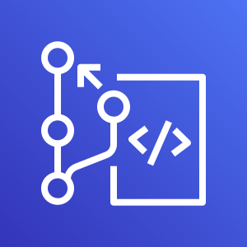
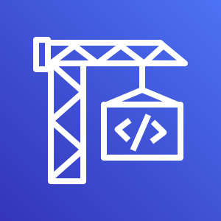
Title Text
The big picture
CodeCommit
CodeBuild
CodeDeploy
Manages your source code and all resources like properties, XML, JSON files for your project.
Builds your projects and creates one or more output artifacts
Deploys your project to your target environment or AWS service and stage

Slide 13
Title Text
The big picture
CodePipeline
Manages the complete build pipeline from source over build to deployment
CodeCommit
CodeBuild
CodeDeploy
Manages your source code and all resources like properties, XML, JSON files for your project.
Builds your projects and creates one or more output artifacts
Deploys your project to your target environment or AWS servie and stage

